Slide 1


Titolo presentazione sottotitolo
Travelling Salesman Problem
A study of move strategies and algorithms
Milano, XX mese 20XX

Slide 2
Problem definition
n cities
All cities must be visited once
Closed path variant (e.g. A-B-C-D-E-A, n = 5)
A tour is defined by n links
n!/2 different possible tours
NP-hard problem
Benchmark for optimization algorithms

Slide 3
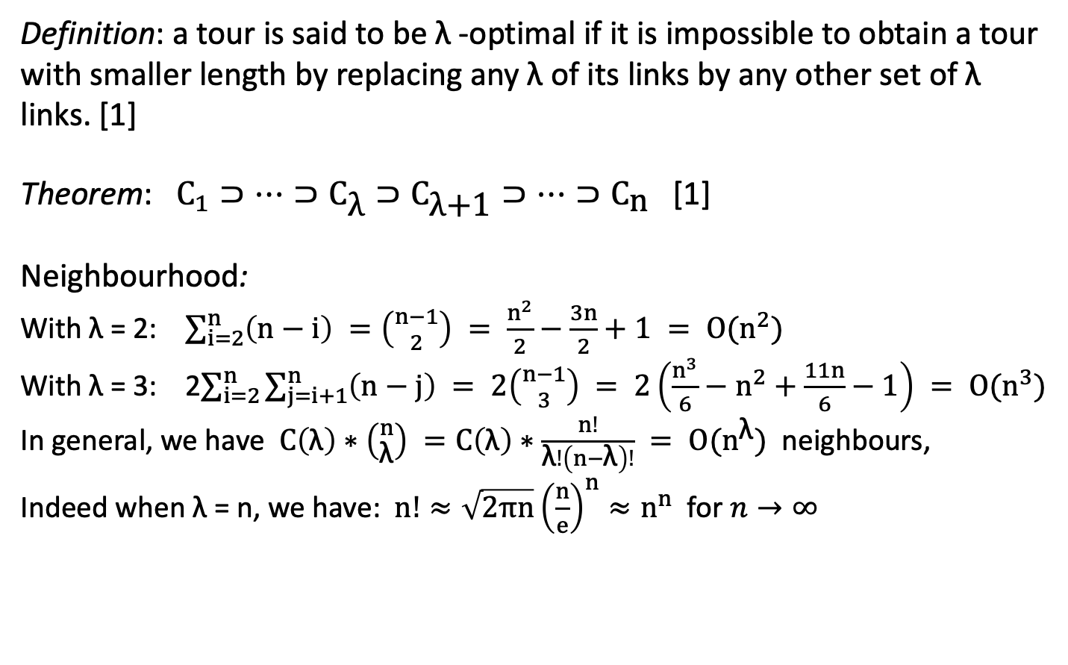
λ-optimality
Definition: a tour is said to be λ -optimal if it is impossible to obtain a tour with smaller length by replacing any λ of its links by any other set of λ links. [1]
Theorem: $C_{1}⊃…⊃C_{\text{λ}}⊃C_{\text{λ}\text{+1}}⊃…⊃C_{\text{n}}$ [1]
Neighbourhood:
With λ = 2: $\sum_{i=2}^{n}{\left(n−i\right) =\left({n−1 \atop 2}\right) = \frac{n^{2}}{2}−\frac{3n}{2}+1 = O(n^{2})}$
With λ = 3: 2$\sum_{i=2}^{n}{\sum_{j=i+1}^{n}{\left(n−j\right) = 2\left({n−1 \atop 3}\right) = 2\left(\frac{n^{3}}{6}−n^{2}+\frac{11n}{6}−1\right) = O(n^{3})}}$
In general, we have ${C\left(\text{λ}\right)∗\left({n \atop \text{λ}}\right) =C\left(\text{λ}\right)∗\frac{n!}{\text{λ}!\left(n−\text{λ}\right)!} = O(n}^{\text{λ}})$ neighbours,
Indeed when λ = n, we have: $n!≈\sqrt{2πn}{\left(\frac{n}{e}\right)}^{n}≈n^{n}$ for $n→∞$

Slide 4
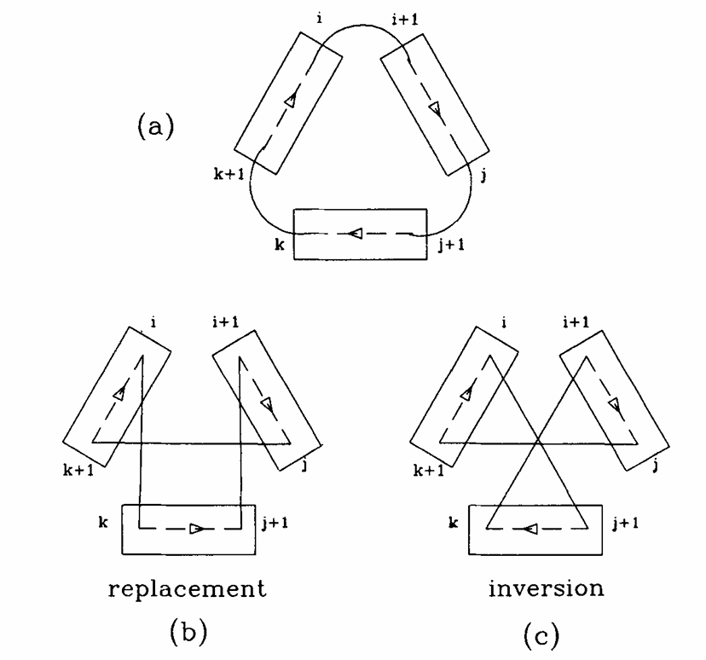
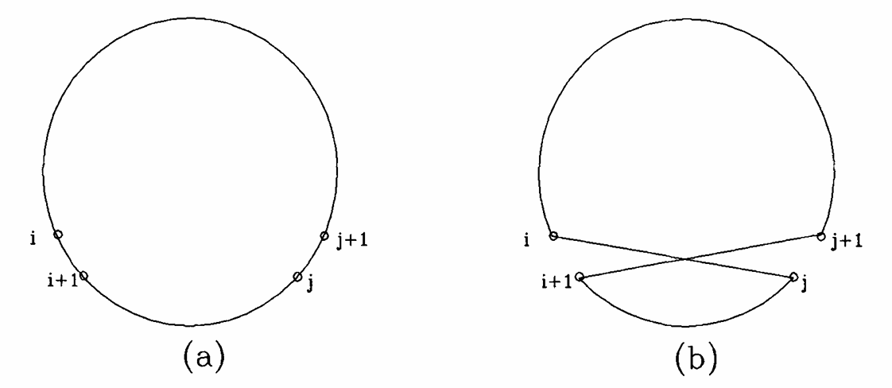
Lin’s 2-links and 3-links moves

Slide 5
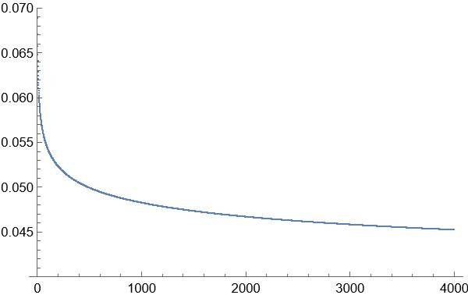
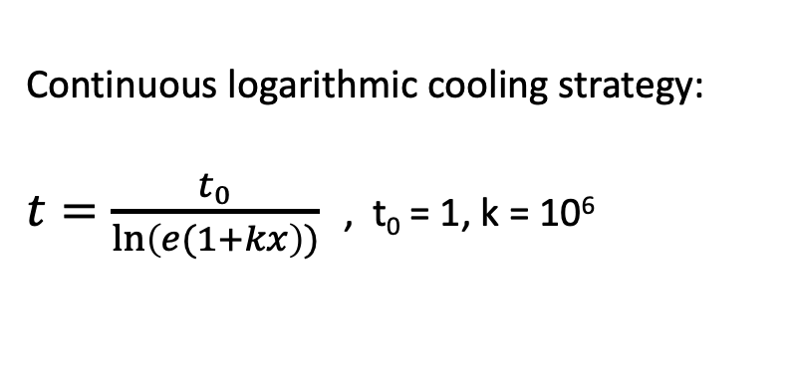
The algorithms
Two-cities-exchange, 2-optimal and 3-optimal deterministic algorithms (at each step all neighbours are visited).
Two-cities-exchange, 2-links and 3-links Random Proposal algorithms (simulated annealing with T=0).
Two-cities-exchange, 2-links and 3-links Simulated Annealing.
Continuous logarithmic cooling strategy:
$t=\frac{t_{0}}{\ln\left(e(1+kx\right))}$ , t₀ = 1, k = 10⁶

Slide 6
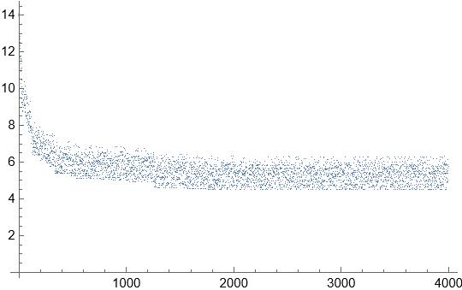
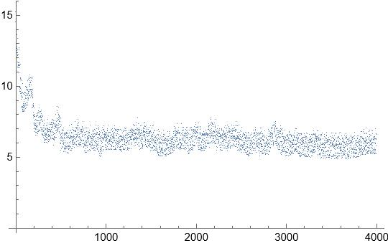
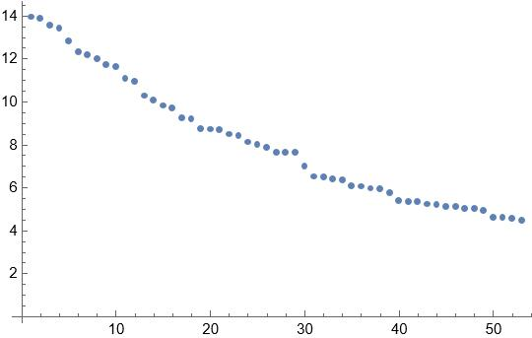
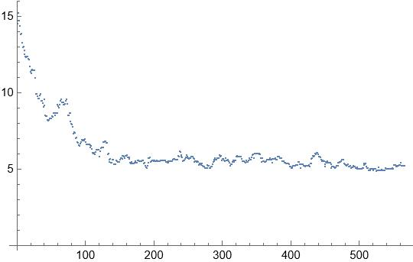
Simulated Annealing: cooling strategy
Proposed tour lengths during a RP run
Proposed tour lengths during a SA run
Accepted tour lengths during a RP run
Accepted tour lengths during a SA run

Slide 7
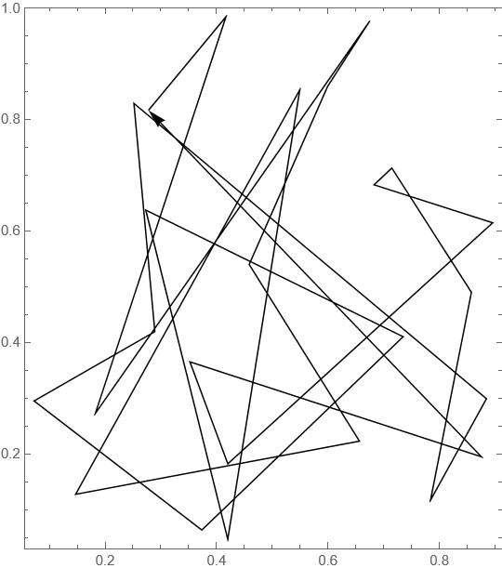
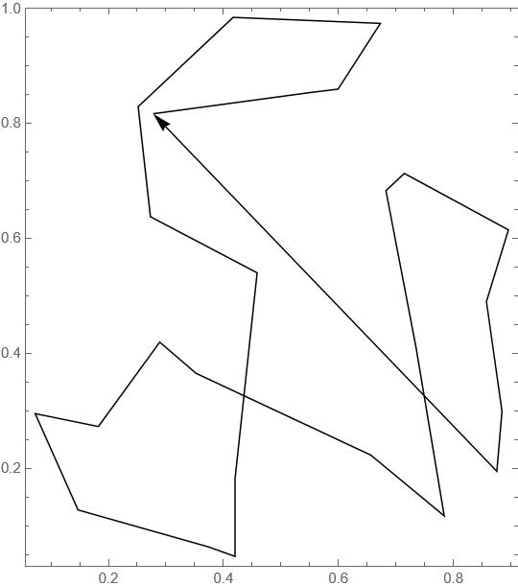
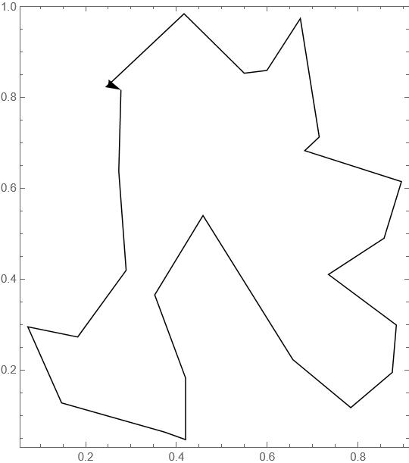
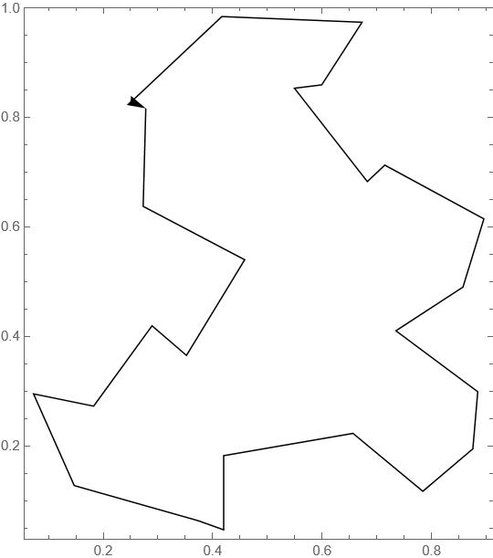
Deterministic algorithms: move strategy
Two-exchange sol. after 16 steps
Length = 5.30281
2-optimal sol. after 18 steps
Length = 4.08234
3-optimal sol. after 15 steps
Length = 3.8312
Starting tour for n=25

Slide 8
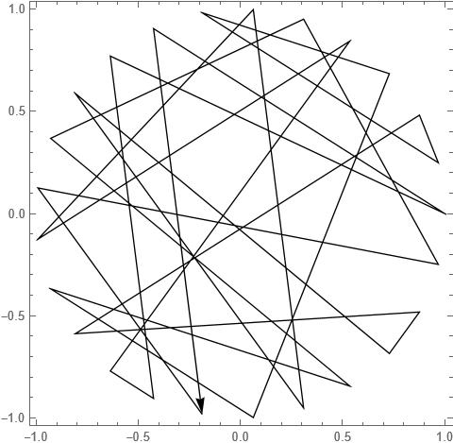
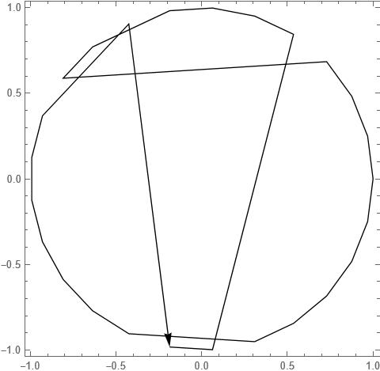
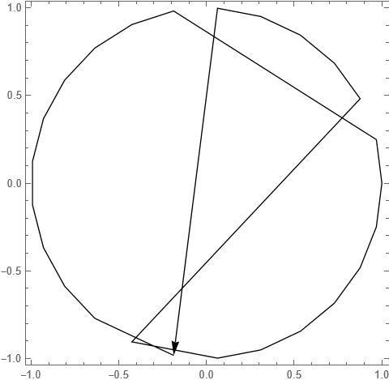
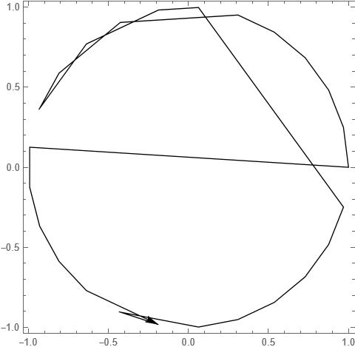
Fixed cost: two-exchange move (polygon)
Deterministic sol. after 15 steps
Length =12.0778
Random proposal sol. after 4140 steps
Length = 11.2753
Simulated annealing sol. after 4140 steps
Length = 11.0216
Starting tour for n=25

Slide 9
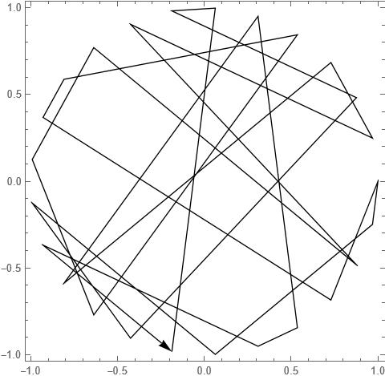
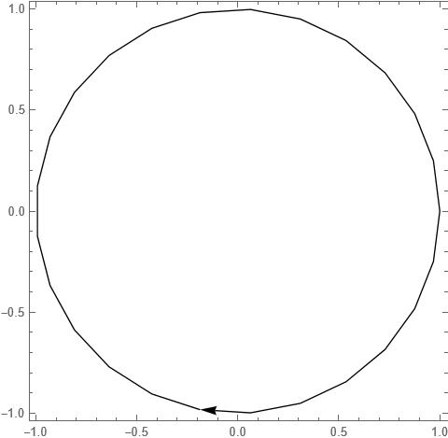

Fixed cost: 2-links move (polygon)
Deterministic sol. after 16 steps
Length =6.26666
Random proposal sol. after 4416 steps
Length = 6.26666
Simulated annealing sol. after 4692 steps
Length =6.26666
Starting tour for n=25

Slide 10
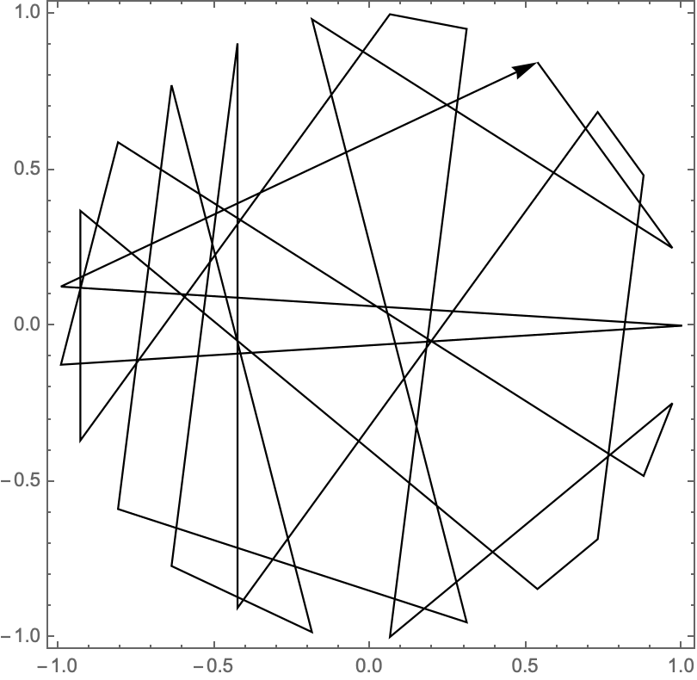
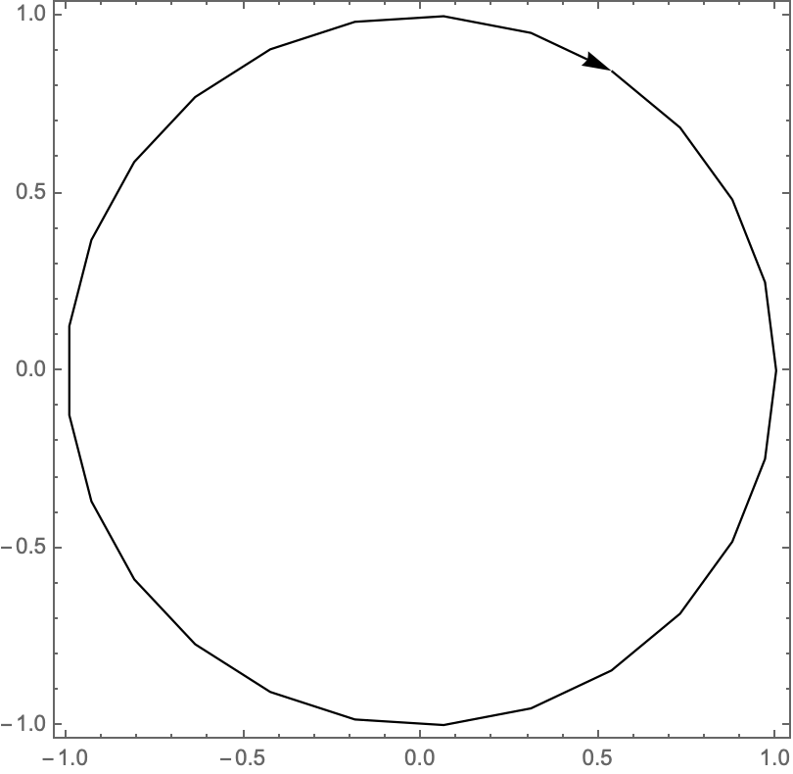
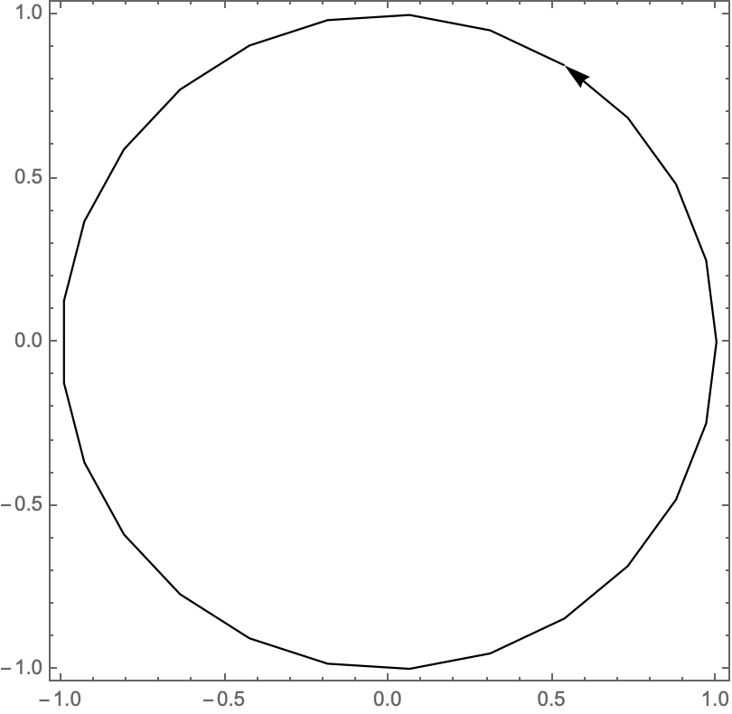
Fixed cost: 3-links move (polygon)
Deterministic sol. after 12 steps
Length =6.26666
Random proposal sol. after 48576 steps
Length = 6.26666
Simulated annealing sol. after 48576 steps
Length =6.26666
Starting tour for n=25

Slide 11
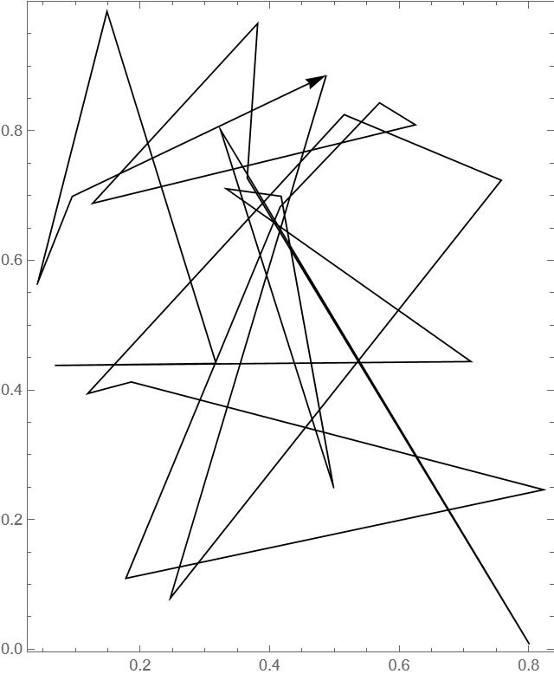
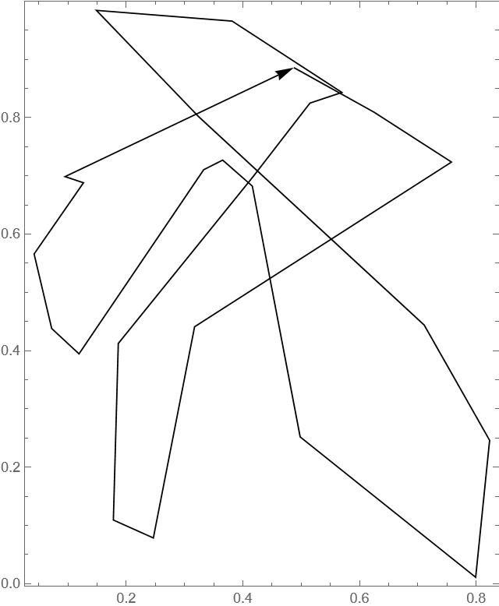
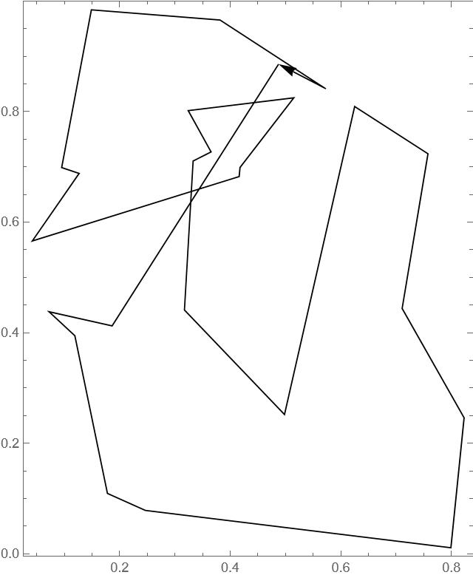
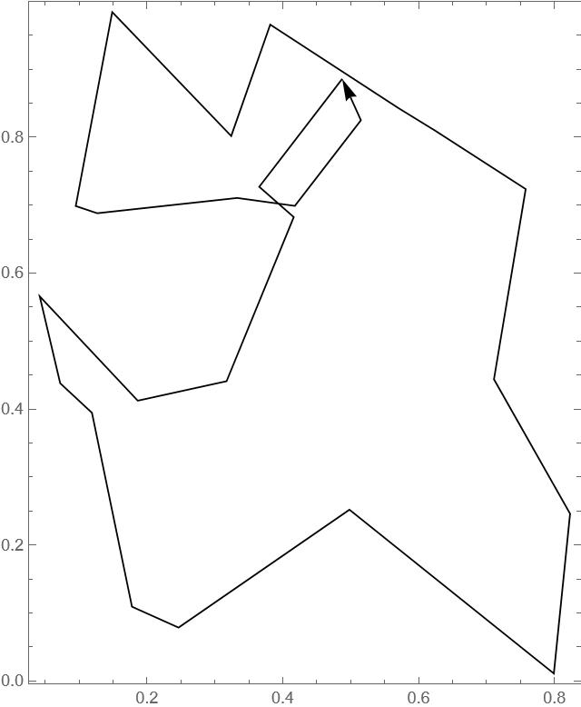
Fixed cost: two-exchange (random)
Deterministic sol. after 17 steps
Length = 5.99271
Random proposal sol. after 4692 steps
Length = 5.57648
Simulated annealing sol. after 4692 steps
Length = 4.58911
Starting tour for n=25

Slide 12
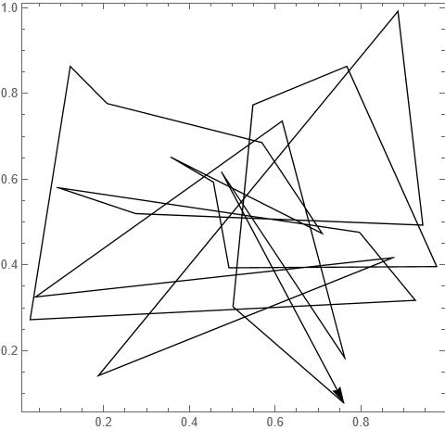
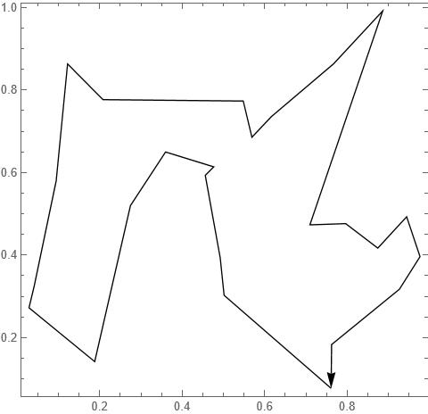
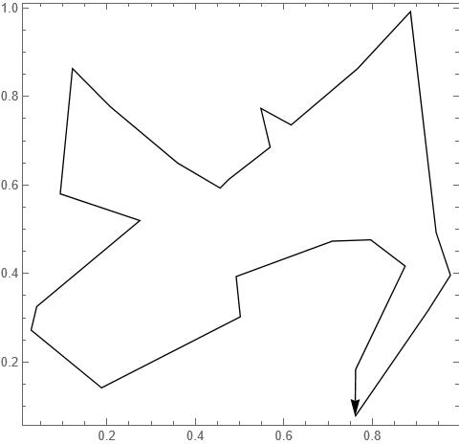
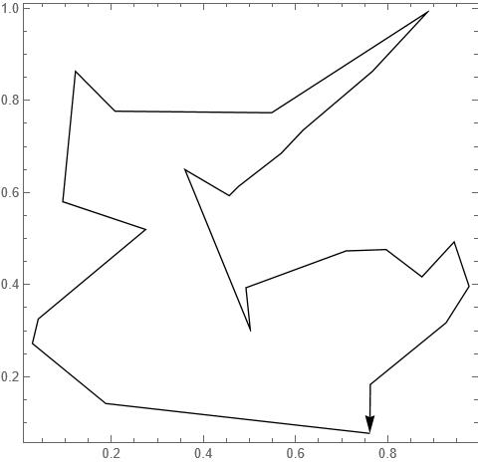
Fixed cost: 2-links move (random)
Deterministic sol. after 18 steps
Length = 4.48167
Random proposal sol. after 4968 steps
Length = 4.37178
Simulated annealing sol. after 4968 steps
Length = 4.67977
Starting tour for n=25

Slide 13
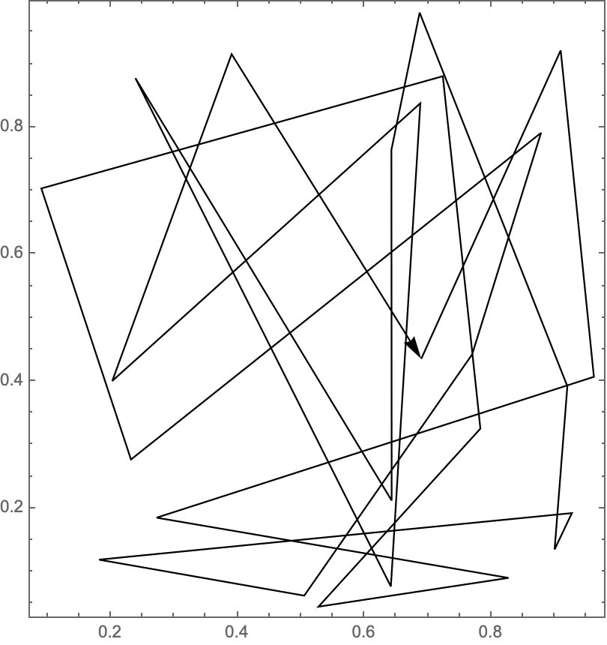
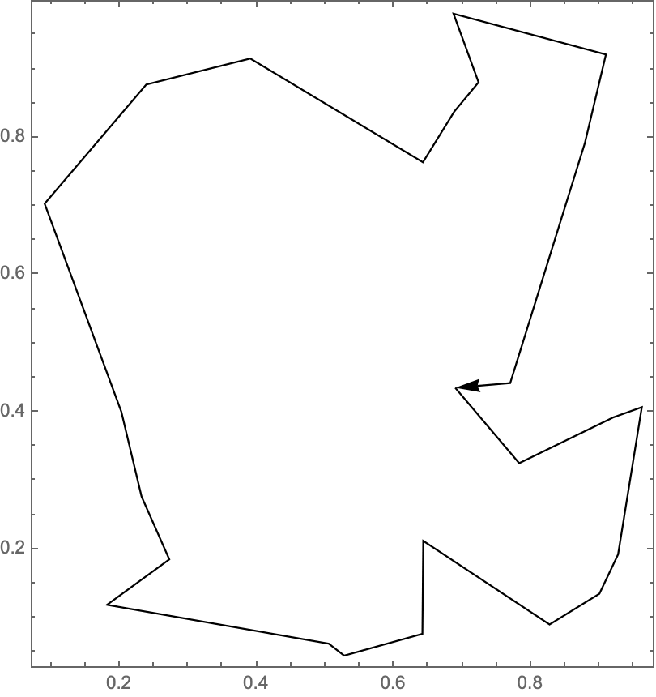
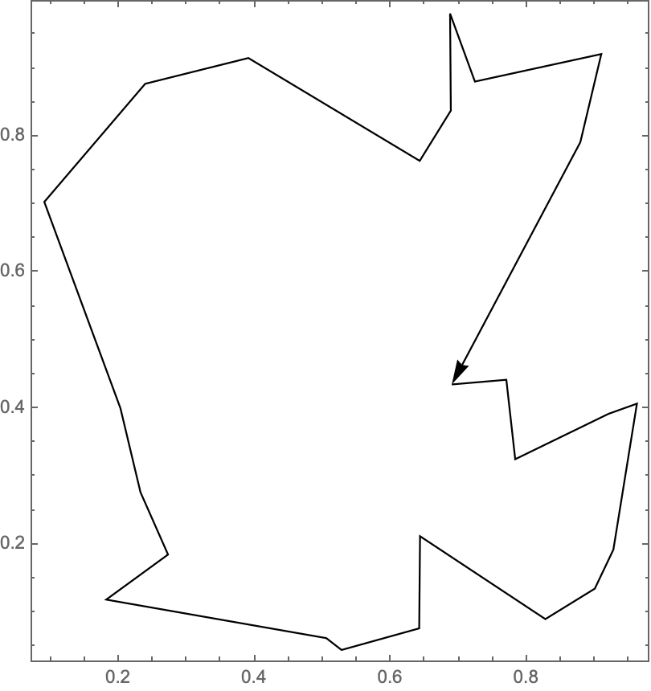
Fixed cost: 3-links move (random)
Deterministic sol. after 15 moves
Length = 3.93888
Random proposal sol. after 60720 steps
Length = 3.93888
Simulated annealing sol. after 60720 steps
Length = 3.99684
Starting tour for n=25

Slide 14
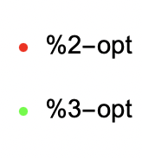
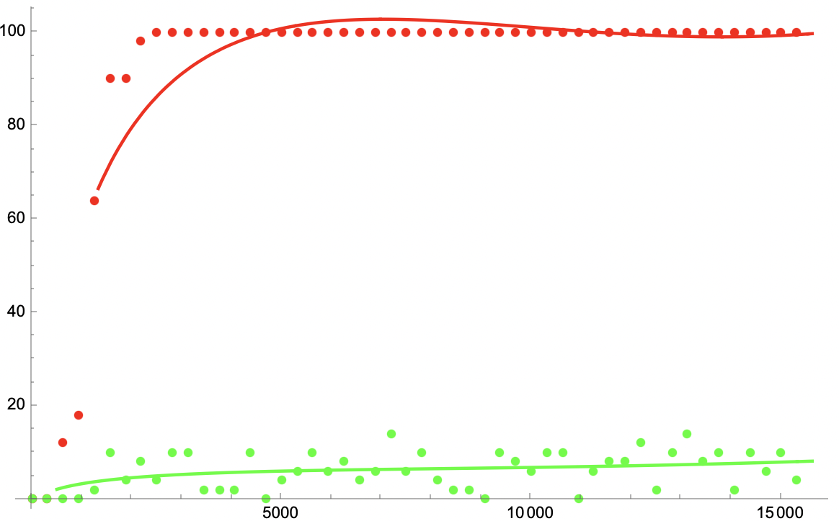
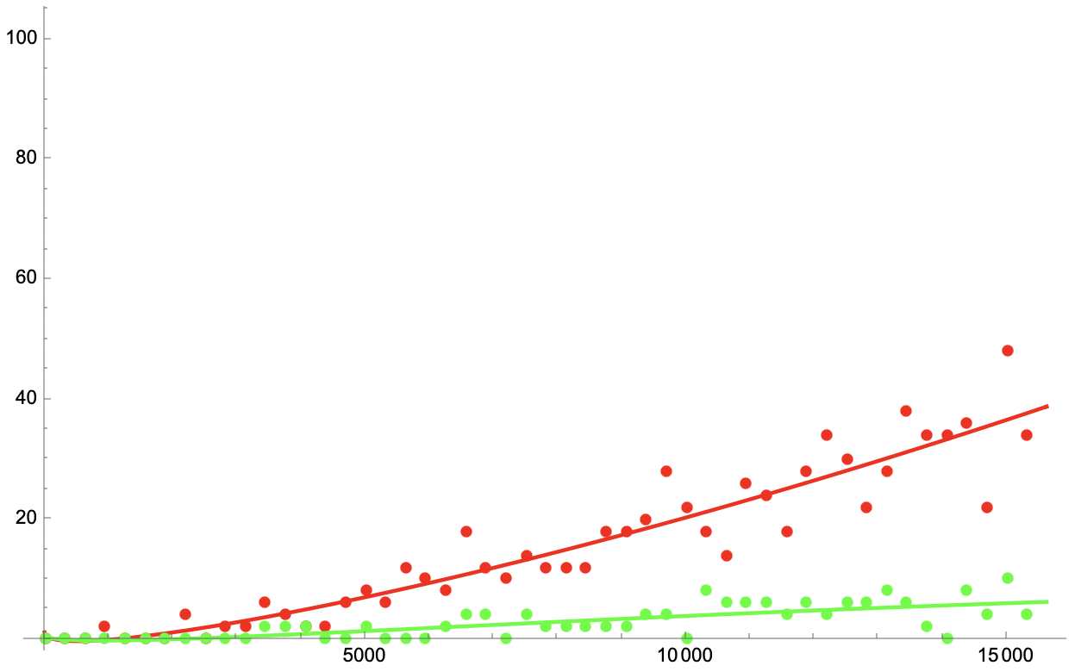
2-optimal and 3-optimal percentages
n=25, 2-links, $k={10}^{6}$, ntemp = $n^{3}$, 50 replicas
Random Proposal
Simulated Annealing

Slide 15
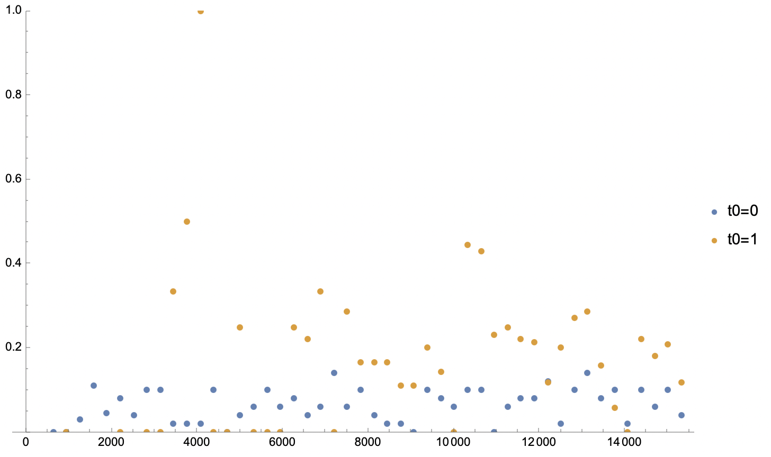
3-optimal percentage over 2-optimal solutions
n=25, 2-links, $k={10}^{6}$, ntemp = $n^{3}$, 50 replicas

Slide 16
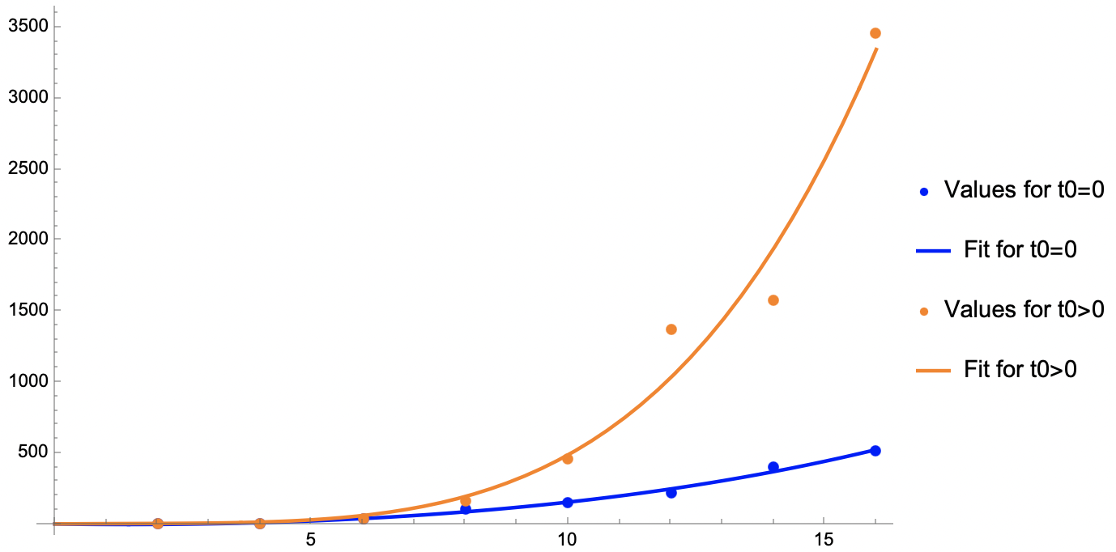
Cost estimation
ntemp-opt vs n-cities (ntemp-opt: ntemp s.t. % 2-opt = 68%)

Slide 17
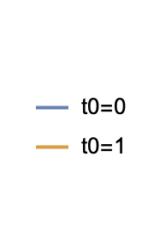
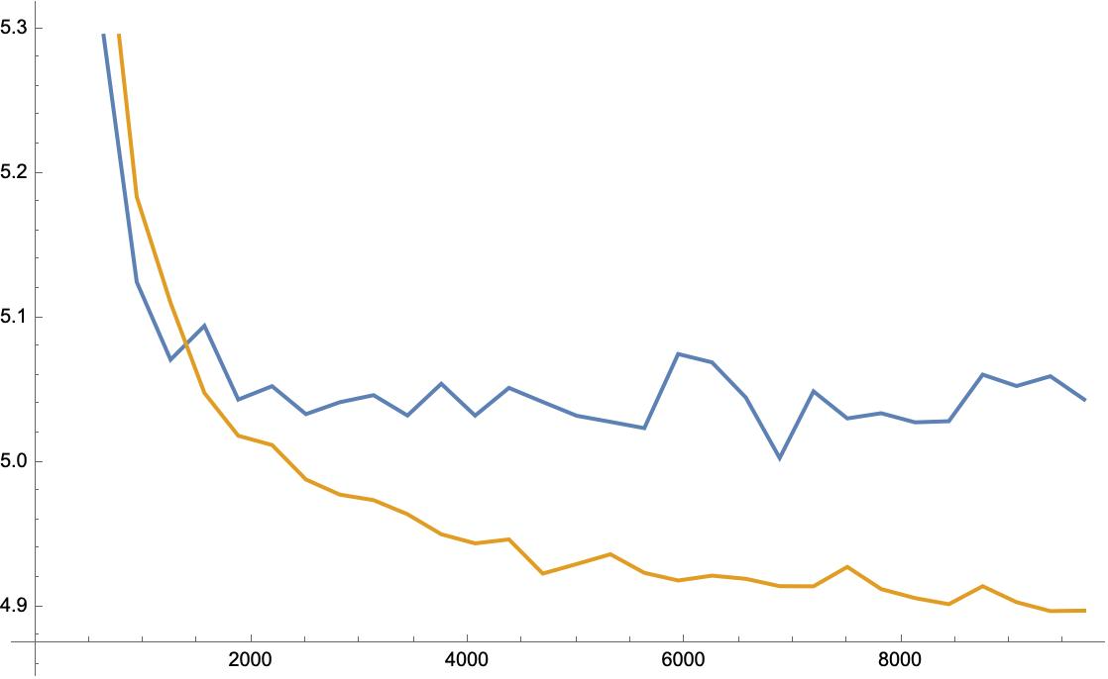
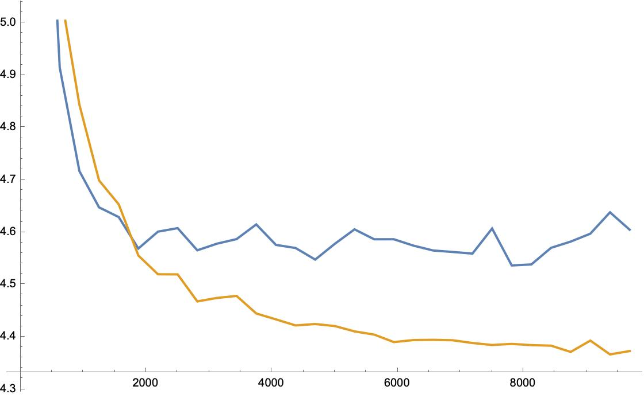
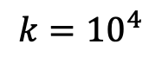
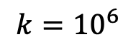
Replicas average minimum lengths
n = 25, 2-Links, ntemp = 10 000, 50 replicas
$$k={10}^{6}$$
$$k={10}^{4}$$
(The figures refer to different starting city arrangements - always random)

Slide 18
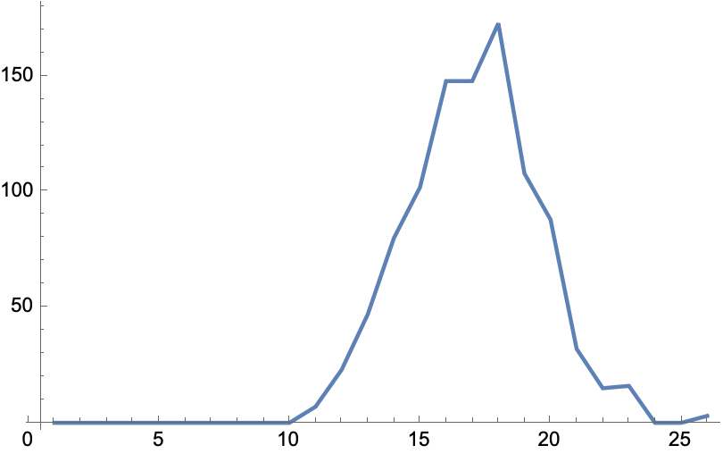
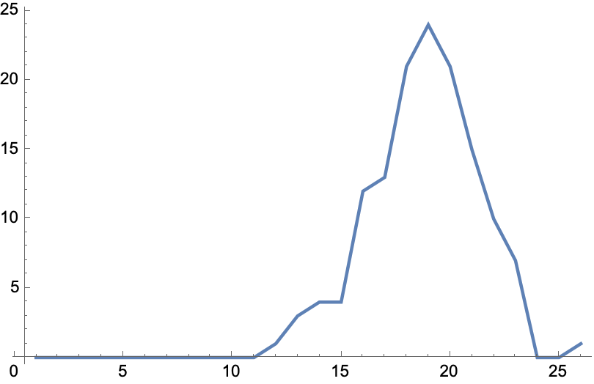
2-optimal overlaps distribution
n=25, 2-links, $k={10}^{6}$, ntemp = ntemp-opt, 50 replicas
Random Proposal
Simulated Annealing

Slide 19
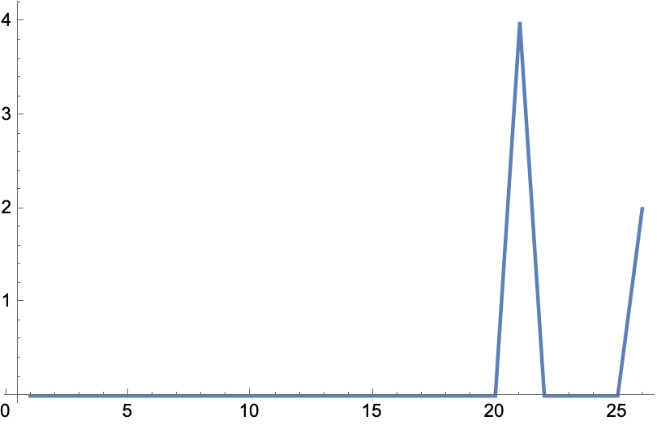
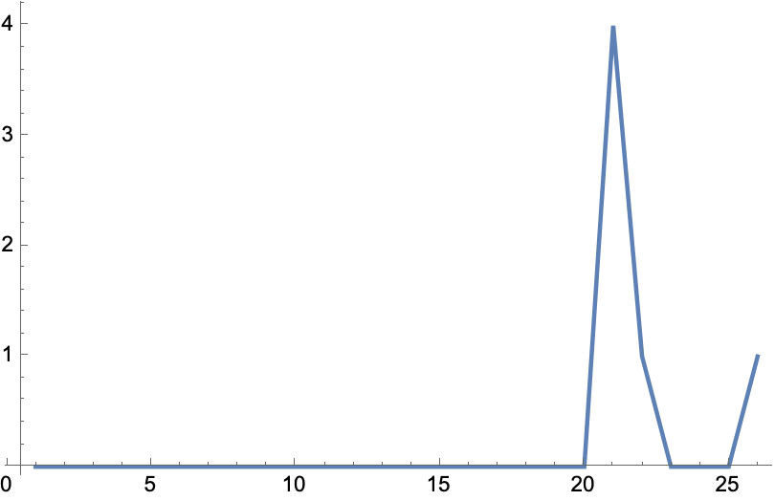
3-optimal overlaps distribution
n=25, 2-links, $k={10}^{6}$, ntemp = ntemp-opt, 50 replicas
Random Proposal
Simulated Annealing

Slide 20
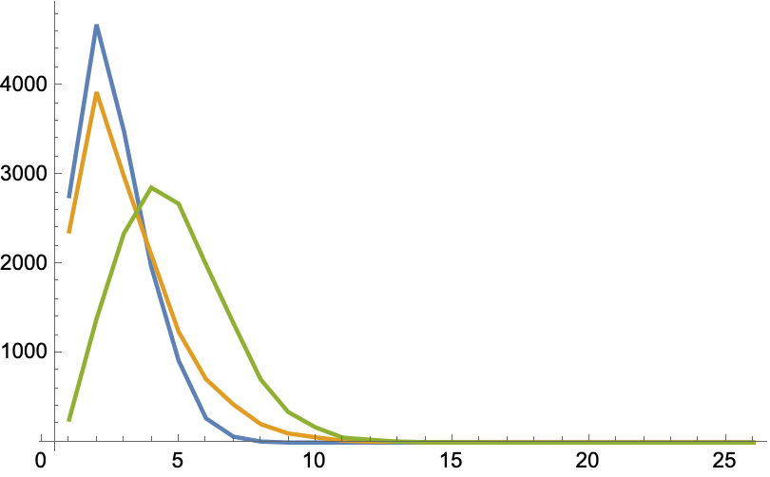
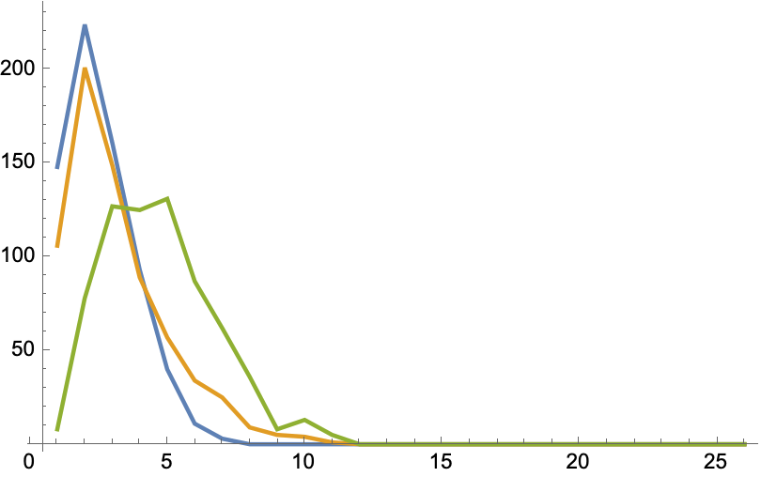
2-optimal triplets overlap distributions
n=25, 2-links, $k={10}^{6}$, ntemp = ntemp-opt, 50 replicas
Random Proposal
Simulated Annealing

Slide 21
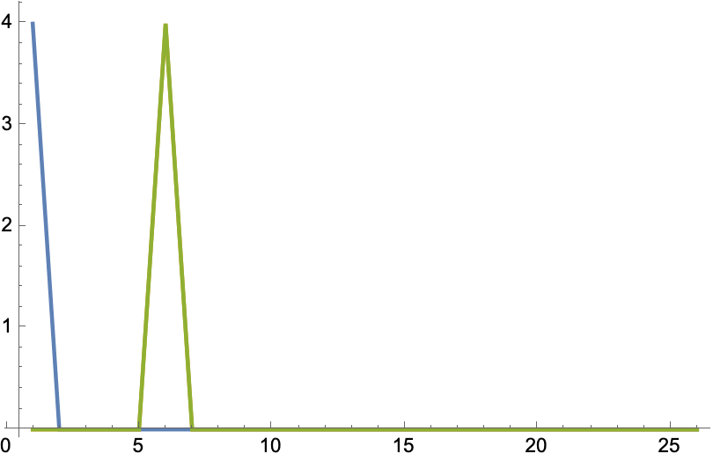

3-optimal triplets overlap distributions
n=25, 2-links, $k={10}^{6}$, ntemp = ntemp-opt, 50 replicas
Random Proposal
Simulated Annealing

Slide 22
Bibliography
[1] Lin, S. (1965). Computer Solutions of the Traveling Salesman Problem. Bell System Technical Journal, 44(10), 2245–2269. doi: 10.1002/j.1538-7305.1965.tb04146.x
[2] Černý, V. (1985). Thermodynamical approach to the traveling salesman problem: An efficient simulation algorithm. Journal of Optimization Theory and Applications, 45(1), 41–51. doi: 10.1007/bf00940812
[3] Kirkpatrick, S., & Toulouse, G. (1985). Configuration space analysis of travelling salesman problems. Journal de Physique, 46(8), 1277–1292. doi: 10.1051/jphys:01985004608
[4] Venkataraman, G., & Athithan, G. (1991). Spin glass, the travelling salesman problem, neural networks and all that. Pramana, 36(1), 1–77. doi: 10.1007/bf02846491

